Slide 1
Hotel Booking Analysis
Vaishnavi Mangesh Burkul

Slide 2
Introduction to Hotel Booking Analysis
The purpose of hotel booking analysis is to delve into the wealth of data generated by reservations, guest interactions, and operational processes within the hospitality industry. This analytical exploration aims to extract meaningful insights that empower hoteliers to make informed decisions, enhance operational efficiency, and elevate the overall guest experience.

Slide 3
About Dataset
For this analysis, we utilize the "Hotel Booking Analysis" dataset, available on platforms like Kaggle. This dataset includes information on hotel bookings, encompassing factors such as booking dates, types of rooms, meal preferences, and customer Types. Additionally, it provides details about cancellations and special requests, offering a comprehensive view of the booking process.

Slide 4
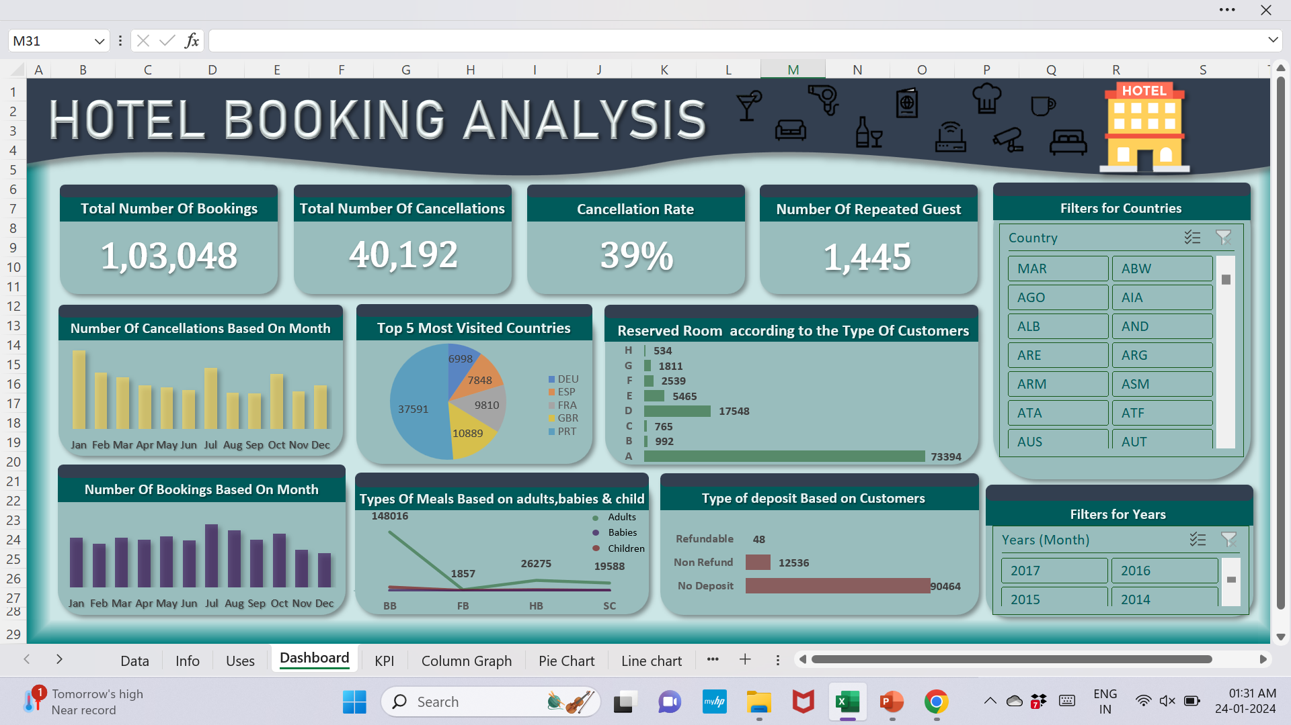
Overview of Hotel Booking Analysis Dashboard

Slide 5
KPIs(Key Performance Indicators)
1. The primary goal of examining the total number of bookings is to understand the volume of reservations over a specified period. This key performance indicator (KPI) helps us gauge the popularity of our hotel, assess demand trends, and make informed decisions to optimize our services.

Slide 6
2. The total number of cancellations is to gain a comprehensive understanding of the reasons behind cancellations, identify patterns, and formulate strategies to mitigate potential losses.
3. Our objective in analyzing cancellation rates is to gain insights into the frequency of cancellations, identify contributing factors, and develop targeted strategies to minimize their impact on our hotel operations.
4. The number of repeated guests is to identify patterns, trends, and preferences exhibited by loyal customers. This analysis allows us to tailor strategies that enhance guest satisfaction and encourage repeat bookings.

Slide 7
Column Graphs
1. Number of Cancellation based on months
Introduction: In our hotel booking analysis, we explore the dynamics of cancellations across different months. Visualizing this data through a column graph in Excel provides a powerful means to identify patterns, trends, and potential areas for strategic intervention.
Graph Overview:
The column graph displays the number of cancellations for each month.
Months are represented on the horizontal axis, while the vertical axis shows the corresponding number of cancellations.

Slide 8
2.Number of Booking Based on Months
Introduction: In our hotel booking analysis, understanding the distribution of bookings across different months is pivotal for strategic planning and resource allocation. Visualizing this data through a column graph in Excel provides a clear and concise representation of booking trends over time.
Graph Overview:
The column graph illustrates the number of bookings for each month.
Months are displayed on the horizontal axis, while the vertical axis represents the corresponding number of bookings.

Slide 9
Pie Chart
Top 5 Most Visited Countries
Introduction: In our hotel booking analysis, understanding the popularity of destinations is paramount for tailoring marketing efforts and optimizing guest experiences. Visualizing the top 5 most visited countries through a pie chart in Excel offers a compelling representation of traveler preferences.
Chart Overview:
The pie chart succinctly displays the number of distribution of bookings across the top 5 most visited countries.
Each slice of the pie represents a specific country, and the size of the slice corresponds to its proportion of total bookings.

Slide 10
Line Graph
Types Of Meals Based On adults, Babies & Children
Introduction: In our hotel booking analysis, understanding the meal preferences based on guest demographics is crucial for offering personalized services. Visualizing these preferences through a line graph in Excel provides a dynamic representation of trends in meal choices for adults, babies, and children.
Graph Overview:
The line graph illustrates the changing trends in meal preferences over time for adults, babies, and children.

Slide 11
Bar Graphs
1. Reserved Room Types by Customer Type
Introduction: In our hotel booking analysis, understanding the distribution of reserved room types based on customer segments is essential for optimizing room allocation and providing tailored experiences. Visualizing this data through a bar graph in Excel offers a comprehensive representation of room preferences across different customer types.
Graph Overview:
The bar graph visually presents the proportion of reserved room types for various customer segments.
Customer types are displayed on the horizontal axis, while the vertical axis denotes the percentage distribution of reserved room types.

Slide 12
2. Type of deposits by Customers
Introduction: In our hotel booking analysis, understanding the deposit preferences based on customer segments is crucial for financial planning and ensuring a smooth booking process. Visualizing this data through a bar graph in Excel provides a clear representation of deposit types favored by different customer categories.
Graph Overview:
The bar graph visually displays the distribution of deposit types for various customer segments.
Customer types (e.g., individual guests, groups, corporate clients) are shown on the horizontal axis, while the vertical axis represents the percentage distribution of deposit types.

Slide 13
Slicers
Slicer Analysis - Countries and Years in Hotel Booking Dashboard
Introduction: In our hotel booking analysis, utilizing slicers in Excel provides an interactive and user-friendly way to filter and explore data. Incorporating slicers for countries and years allows users to dynamically analyze booking trends and performance metrics based on specific geographical regions and timeframes.
Slicer Overview:
Slicers are interactive visual filters that enable users to quickly narrow down data based on selected criteria.
Two primary slicers will be implemented: one for countries and another for years.

Slide 14
Conclusion:
In conclusion, the hotel booking analysis dashboard, offers valuable insights into booking trends, guest preferences, and operational efficiency. By analyzing key metrics such as lead time, revenue, and guest demographics, it enables informed decision-making, personalized guest experiences, and revenue optimization. Moving forward, this data-driven approach will drive ongoing improvements, ensuring our hotel remains competitive and delivers exceptional experiences to our guests.

Slide 15
Thank You!
Thank you for your attention and participation in this presentation. Your engagement and interest in the hotel booking analysis dashboard are greatly appreciated.

